Slide 1
Decision Trees & Random Forests

Slide 2
Decision and Regression Trees

Slide 3
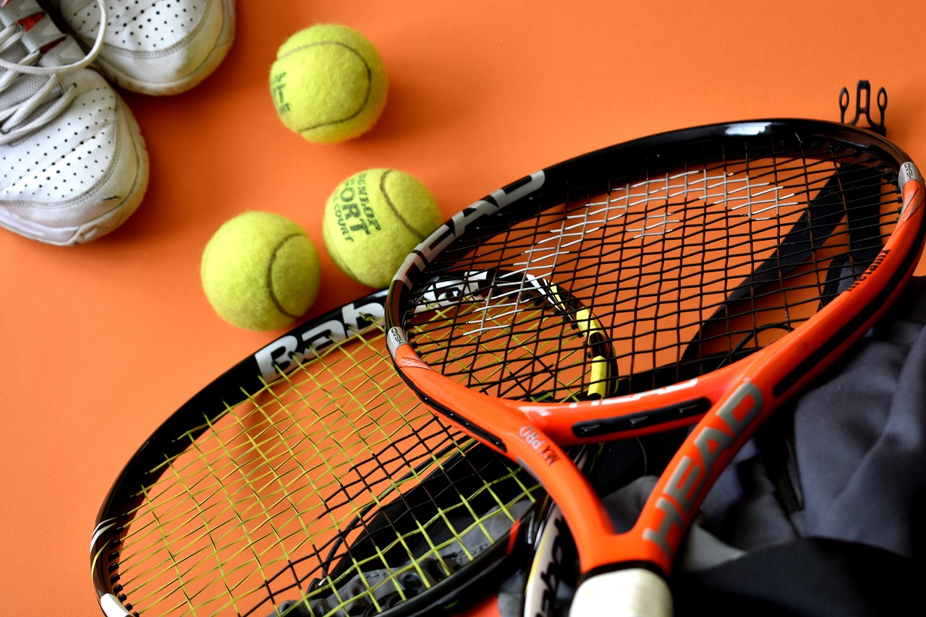

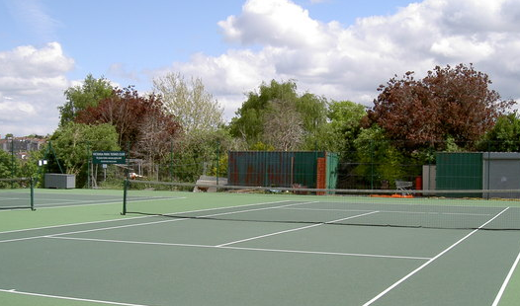

Notes:
https://www.maxpixel.net/Tennis-Balls-Tennis-Sport-Equipment-Racket-Sport-3554019
https://pxhere.com/en/photo/1039809
https://www.geograph.org.uk/photo/3482116

Slide 4
Day | Outlook | Temp | Humidity | Wind | Play Tennis?
0 l | Sunny | Hot | High | Weak | No
02 | Sunny | Hot | High | Strong | No
03 | Overcast | Hot | High | Weak | Yes
04 | Rain | Mild | High | Weak | Yes
05 | Rain | Cool | Nml | Weak | Yes
06 | Rain | Cool | Nml | Strong | No
07 | Overcast | Cool | Nml | Strong | Yes
08 | Sunny | Mild | High | Weak | No
09 | Sunny | Cool | Nml | Weak | Yes
10 | Rain | Mild | Nml | Weak | Yes
11 | Sunny | Mild | Nml | Strong | Yes
12 | Overcast | Mild | High | Strong | Yes
13 | Overcast | Hot | Nml | Weak | Yes
14 | Rain | Mild | High | Strong | No
Notes:
Over the course of two weeks, we monitor 1) the weather and 2) whether or not we play tennis

Slide 5
Day | Outlook | Temp | Humidity | Wind | Play Tennis?
0 l | Sunny | Hot | High | Weak | No
02 | Sunny | Hot | High | Strong | No
03 | Overcast | Hot | High | Weak | Yes
04 | Rain | Mild | High | Weak | Yes
05 | Rain | Cool | Normal | Weak | Yes
06 | Rain | Cool | Normal | Strong | No
07 | Overcast | Cool | Normal | Strong | Yes
08 | Sunny | Mild | High | Weak | No
09 | Sunny | Cool | Normal | Weak | Yes
10 | Rain | Mild | Normal | Weak | Yes
11 | Sunny | Mild | Normal | Strong | Yes
12 | Overcast | Mild | High | Strong | Yes
13 | Overcast | Hot | Normal | Weak | Yes
14 | Rain | Mild | High | Strong | No
Our choice to play tennis depends on the weather

Slide 6
Decision Trees
Temperature
Predict whether or not we play tennis from temperature, humidity, wind, etc.
Segment data based on features to predict results
Cool
>= Mild
No
Tennis
Play
Tennis
Notes:
Trying to make a rule book for determining whether or not to play based on the weather outside.
First consider temperature. Do not play if it is cool. Do play if mild or warmer.
Explore the “mild/hot” branch in closer detail. Humidity affects this branch.

Slide 7
Decision Trees
Nodes
Depth = 2
Temperature
Predict whether or not we play tennis from temperature, humidity, wind, etc.
Segment data based on features to predict results
Trees that predict categorical results are decision trees
Cool
>= Mild
Humidity
No
Tennis
High
Normal
No
Tennis
Play
Tennis
Leaves
Notes:
Mention that the depth of this tree is 2. Depth will be further explored in terms of overfitting shortly

Slide 8
Predictions
Temperature
Once a decision tree is trained, predict by following split decisions
Example:
Mild
High humidity
Overcast
Cool
>= Mild
Humidity
No
Tennis
High
Normal
Outlook
Play
Tennis
Sunny
Rain or Overcast
No
Tennis
Play
Tennis

Slide 9
Predictions
Temperature
Once a decision tree is trained, predict by following split decisions
Example:
Mild
High humidity
Overcast
Cool
>= Mild
Humidity
No
Tennis
High
Normal
Outlook
Play
Tennis
Sunny
Rain or Overcast
No
Tennis
Play
Tennis

Slide 10
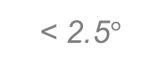
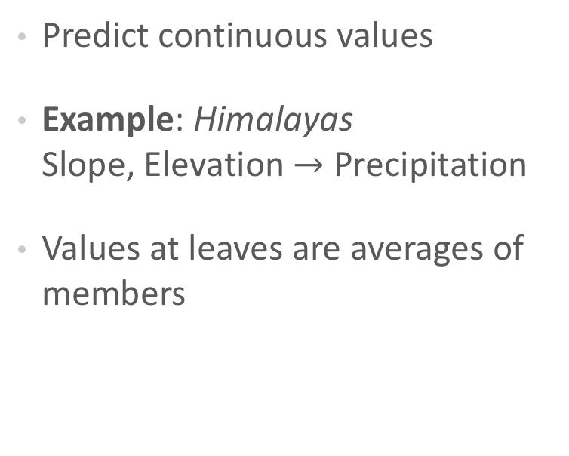
Regression Trees
Elevation
Predict continuous values
Example: Himalayas Slope, Elevation $→$ Precipitation
Values at leaves are averages of members
< 7,900 ft
Slope
55.42 in
< 2.5$°$
Elevation
48.50 in
< 6,200 ft
53.67 in
13.67 in

Slide 11
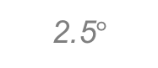
Trees Make Local Predictions
Elevation
Elevation
55.42 in
< 7,900 ft
7,900 ft
Slope
55.42 in
51.67 in
< 2.5$°$
2.5$°$
6,200 ft
Elevation
48.50 in
48.50 in
13.67 in
< 6,200 ft
51.67 in
13.67 in
Slope
Notes:
As opposed to the global predictions that, say, linear or logistic regression makes
Each node corresponds to one region in feature space – Feature space is now subdivided and mapped to make target predictions
Example, slope = 4 degrees, Elevation = 8500 ft -> 55.42”

Slide 12
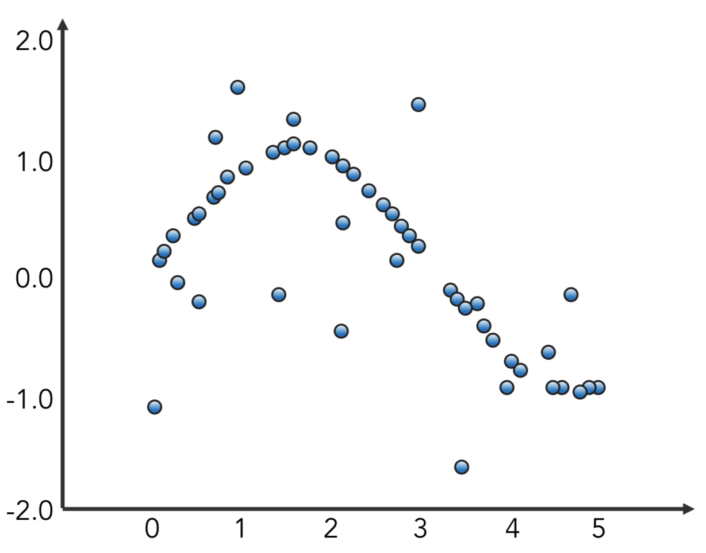
Regression Trees
Target
Feature
Notes:
Build regression tree with one feature
Source: http://scikit-learn.org/stable/auto_examples/tree/plot_tree_regression.html

Slide 13
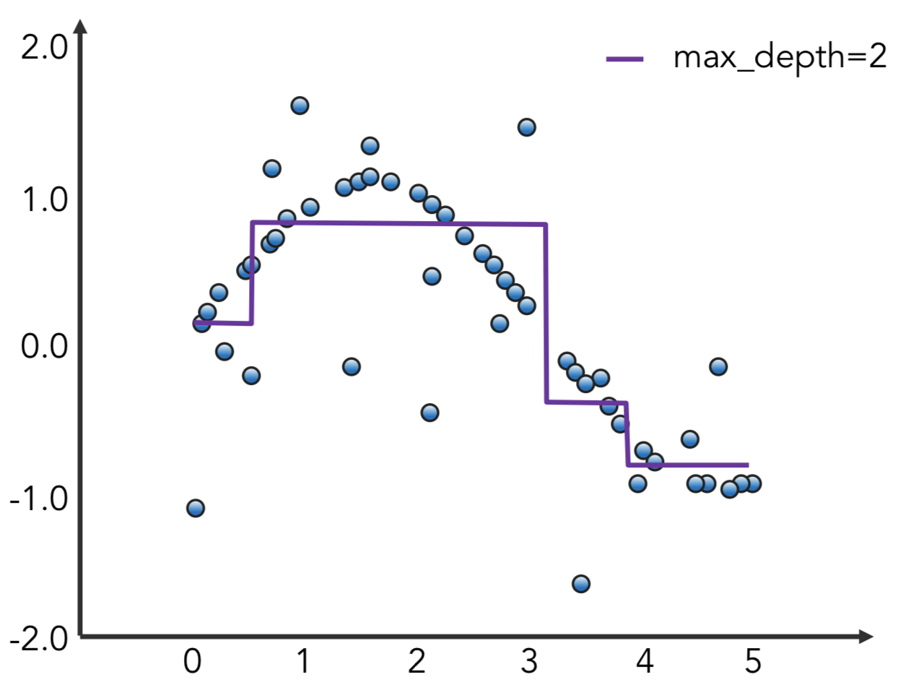
Regression Trees
Target
Feature
Notes:
Model will make local predictions by subdividing the feature space (here just one dimension)
Source: http://scikit-learn.org/stable/auto_examples/tree/plot_tree_regression.html

Slide 14
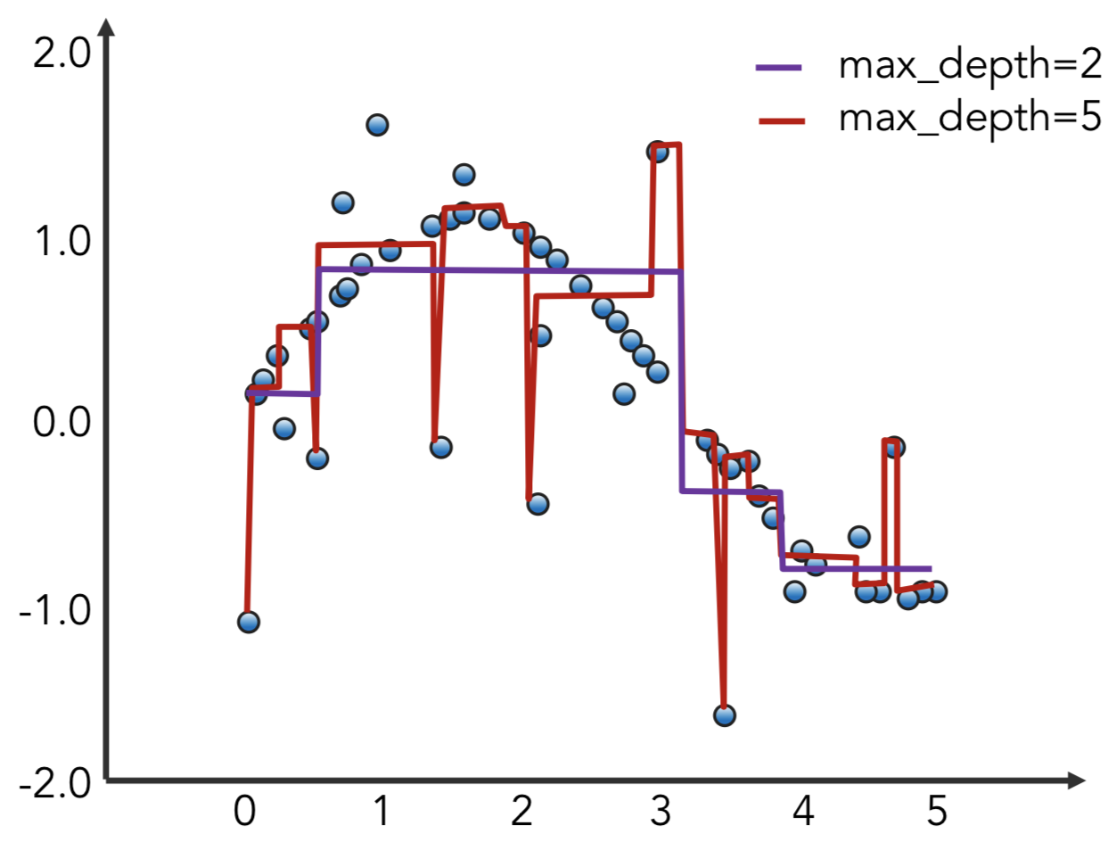
Regression Trees
Target
Feature
Notes:
As the tree depth is increased we quickly start overfitting and modeling the noise in our data. The subdivisions of the feature space are too granular.
Source: http://scikit-learn.org/stable/auto_examples/tree/plot_tree_regression.html

Slide 15
Building a Decision Tree
Feature
Select a feature and split data into binary tree

Slide 16
Building a Decision Tree
Feature
Select a feature and split data into binary tree
Continue splitting on available features
Feature

Slide 17
Building a Decision Tree
Feature
Select a feature and split data into binary tree
Continue splitting on available features
Feature
Feature

Slide 18
How Long to Continue Splitting?
Feature
Split training data until:
Leaf nodes are pure – only one class per leaf
Minimum leaf size or maximum depth reached
Performance metric achieved
Feature
Feature
Feature
Notes:
Splitting until leaves are pure will probably lead to overfitting but it can be difficult to tell whether then next split will potentially dramatically improve fit (horizon effect: https://en.wikipedia.org/wiki/Horizon_effect).

Slide 19
How to Form Each Split?
Use greedy approach: find best split at each step without considering later splits
What is the “best” split?
Feature

Slide 20
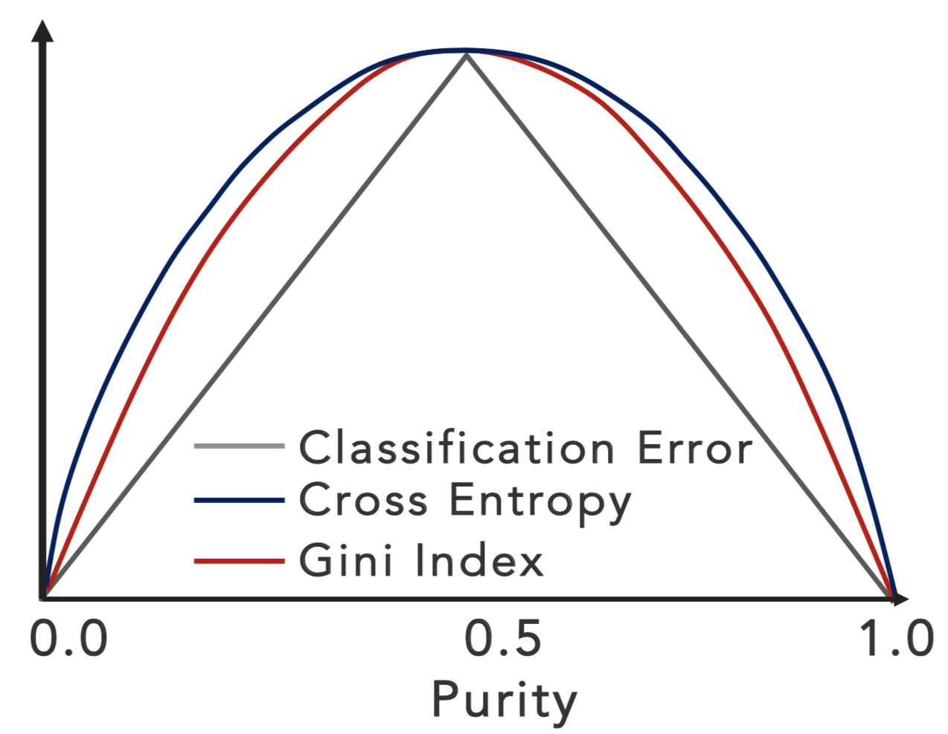
Information Gain and Impurity
Two-class classification
Choose feature and cutpoint to maximize information gain (reduce Gini impurity)
p(y=1)
Notes:
CART uses Gini impurity. Other decision trees use entropy. Sklearn’s default is gini, but can switch to entropy if prefer.
Main reason for using Gini is that the log in the entropy calculation can be avoided with similar performance. Typically do not use classification error directly because it is less sensitive to changes in node probabilities; that is, Gini and cross-entropy reward pure nodes more.
Note: Gini impurity and Gini coefficient are not the same thing, though both are named for Corrado Gini. “Gini impurity is a measure of how often a randomly chosen element from the set would be incorrectly labeled if it was randomly labeled according to the distribution of labels in the subset.” vs “Gini coefficient is a measure of statistical dispersion intended to represent the income or wealth distribution of a nation's residents, and is the most commonly used measurement of inequality.” Unfortunately, they are both referred to as “Gini index” sometimes.

Slide 21
Decision Trees Tend to Overfit
Feature
High variance
Small changes in data greatly affect prediction
Feature
Feature
Feature
SOLUTION
Prune Trees
Notes:
Next two slides show the trees being pruned. Can be passed through quickly

Slide 22
Decision Trees Tend to Overfit
Feature
High variance
Small changes in data greatly affect prediction
Feature
Feature
SOLUTION
Prune Trees

Slide 23
Decision Trees Tend to Overfit
Feature
High variance
Small changes in data greatly affect prediction
Feature
SOLUTION
Prune Trees

Slide 24
Pruning Decision Trees
Feature
Which leaves should be pruned?
Feature
SOLUTION
Prune such that classification errors are minimized
Notes:
Either reduced error pruning or cost-complexity pruning can be used.
Reduced error merely replaces nodes with most popular class; if prediction accuracy isn’t affected, the change is kept.
Cost-complexity pruning (see ESL by Hastie et al pg 308) balances a cost function of two terms: classification errors vs tree size. As tuning parameter is increased (emphasizing tree size over misclassifications), unique smallest subtree exists to minimize cost function. Then we can successively collapse internal nodes that produce the smallest per-node increase in misclassifications (or Gini, entropy).

Slide 25
Decision/Regression Trees
ADVANTAGES
DISADVANTAGES
Easy to interpret
“If… then… else” logic
Any data type, handles missings
No scaling required
OVERFITING
Difficult to generalize to unseen data
Notes:
Data type = continuous, binary, ordinal, categorical, etc.
For missings, just encode as impossible numerical value (say, -999999)

Slide 26
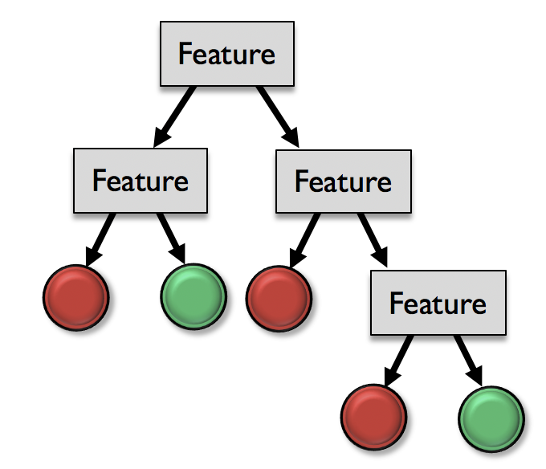
Overcome Variance Issue by Ensembling
Notes:
Question: What happens if we grow multiple trees on the same dataset – Same tree over and over!

Slide 27
Bagging

Slide 28
Bagging: Bootstrap Aggregating
Ensembling: Improve robustness by combining base learners
BAGGING STEPS
Generate new datasets by sampling from training set uniformly with replacement
Fit a tree to each new bootstrapped dataset
Make predictions by aggregating across trees
Notes:
Bagging is one form of ensembling (more about ensembling in a later lecture)
Here, the “base learners” are decision trees

Slide 29
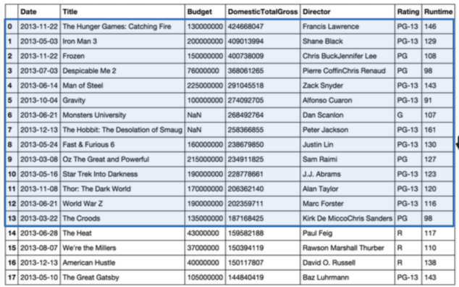
Step 1: Bootstraping
Sample training data uniformly with replacement
Notes:
Blue is training data, yellow is test data
Let’s say I have 100 observations in my training set, I am typically looking to make a new bootstrapped set with 100 observations. During each of these 100 draws for my bootstrapped set, each training observations has 1/100th chance of being selected. (Uniformly with replacement)

Slide 30
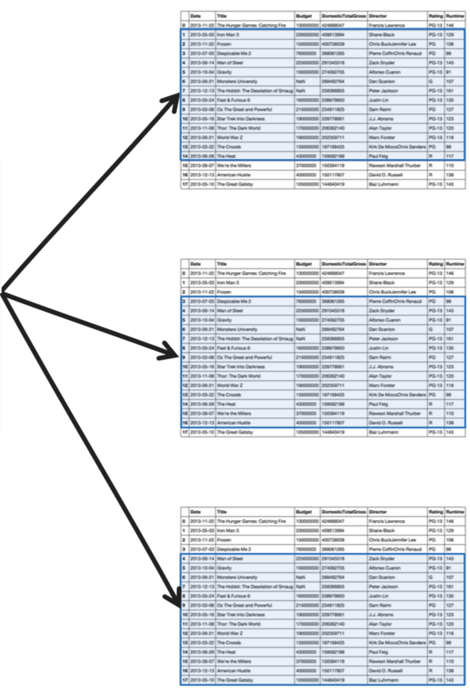
Step 1: Bootstraping
Sample training data uniformly with replacement
Notes:
Blue is training data, yellow is test data
Let’s say I have 100 observations in my training set, I am typically looking to make a new bootstrapped set with 100 observations. During each of these 100 draws for my bootstrapped set, each training observations has 1/100th chance of being selected. (Uniformly with replacement)

Slide 31
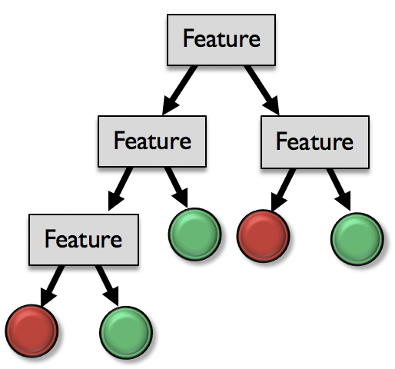
Step 2: Fit tree to each

Slide 32
Step 3: Aggregate results
Classification:
Vote for final prediction
Observation
Regression: Average value

Slide 33
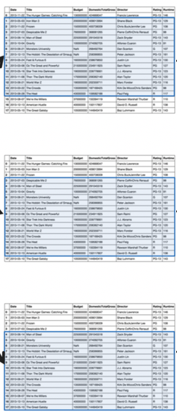
Bagging
Including more trees reduces variance without greatly increasing bias
Corrects decision tree overfitting
Can yield correlated trees if some features especially strong predictors
SOLUTION
Random Forests
Notes:
Note: Correlated trees generally lead to a less generalizable estimator

Slide 34
Random Forests
Bagging with more randomness!

Slide 35
Feature Bagging
Introduce randomness when building each tree
At each split, only consider a subset of the m features
Each feature now has opportunity to influence outcome
Trees now decorrelated
p < m
Notes:
Only consider p features at each split

Slide 36
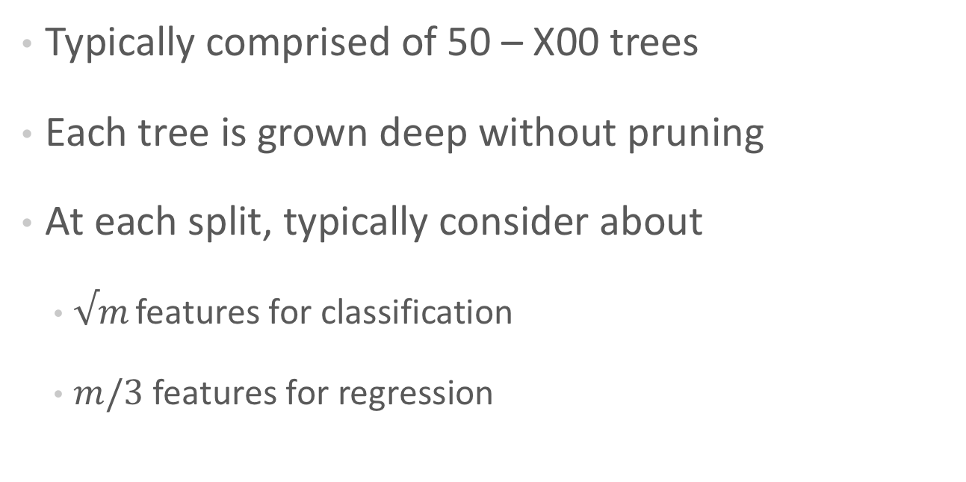
Random Forest Rough Guidelines
Typically comprised of 50 – X00 trees
Each tree is grown deep without pruning
At each split, typically consider about
$√m$ features for classification
$m/3$ features for regression
Notes:
Note: X00 = a few hundred trees
Unfortunatey sklearn’s default is only 10 (version 0.20); In version 0.22 the default will be 100 trees 😁

Slide 37
Out-of-Bag Error
Measure tree error on samples not included in bootstrap
Validate number of trees in forest by monitoring OOB
Notes:
OOB Error can even be monitored while building the forest. Enough trees have been added once OOB stabilizes.
In sklearn, this is rfc.oob_score_ where rfc is your RandomForestClassifier instance.

Slide 38
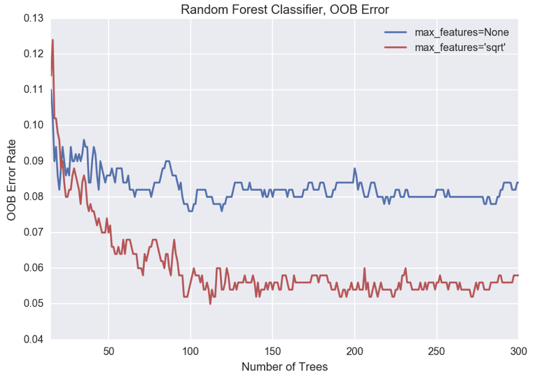
Out-of-Bag Error
Notes:
The max_features argument in sklearn can be used to limit the number of features considered at each split in the trees.
QUESTION: What is the blue line where there are no restrictions on the number of features? (Bagging)
Also QUESTION: Why would we want to stop including more trees? Mostly for speed reasons. Overfitting not a big concern here.
Code reference: http://scikit-learn.org/stable/auto_examples/ensemble/plot_ensemble_oob.html#id2
Note: This RF classification example was made by creating a new random forest for each n_estimators tried – NOT by adding more trees to the same forest – hence the jumpy OOB.

Slide 39
Feature Importance
Rank features as being more or less useful to model
Helps with model interpretability
In sklearn, average Gini importance
Note: Feature importance does not tell you how/why a feature is important
Figure: Hastie 2009
Notes:
Couple of different ways to calculate feature importance, but sklearn does so by averaging the feature’s reduction to Gini impurity across all trees:
https://stackoverflow.com/questions/15810339/how-are-feature-importances-in-randomforestclassifier-determined
https://scikit-learn.org/stable/modules/generated/sklearn.tree.DecisionTreeClassifier.html#sklearn.tree.DecisionTreeClassifier.feature_importances_
Figure: Hastie 2009 Elements of Statistical Learning https://web.stanford.edu/~hastie/Papers/ESLII.pdf

Slide 40
Extra Trees
Extremely Randomized Trees
Instead of bootstrapping, grow trees by selecting random cutpoint for random subset of features at each split
Aggregate across trees to predict
Notes:
Typically faster than RF. Can outperform if several features are noisy.

Slide 41
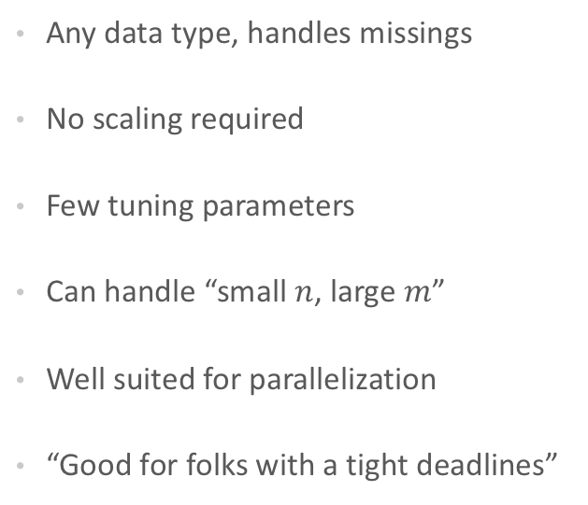
Random Forests
ADVANTAGES
DISADVANTAGES
Any data type, handles missings
No scaling required
Few tuning parameters
Can handle “small $n$, large $m$”
Well suited for parallelization
“Good for folks with a tight deadlines”
Less interpretable than decision trees
Poor with categorical variables with many categories
Other algorithms may outperform (e.g. XGBoost)
Notes:
RF is not great with a bunch of dummy categories. Perhaps instead create ordinal ranking from categoricals based on training targets (lowest percent positive class mapped to lowest ordinal value, etc.) (Reference: p 310 of ESL by Hastie et al)

Slide 42
Questions?

Slide 43
Appendix

Slide 44
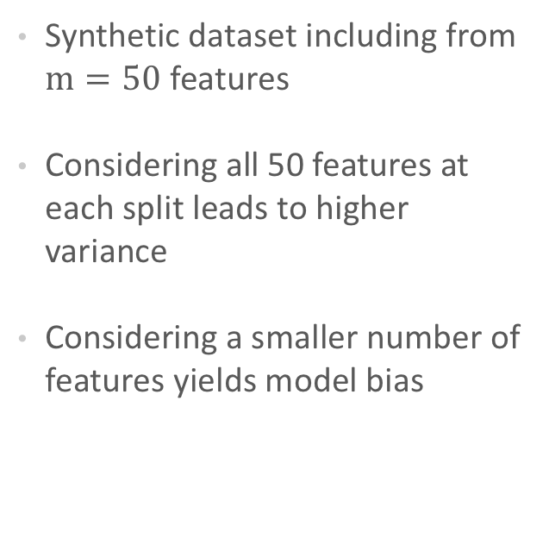
Bias-Variance Tradeoff
Synthetic dataset including from $m=50$ features
Considering all 50 features at each split leads to higher variance
Considering a smaller number of features yields model bias
Figure: Hastie 2009
Bagging
Notes:
Question: Where is bagging on this diagram?
Figure: Hastie 2009 Elements of Statistical Learning https://web.stanford.edu/~hastie/Papers/ESLII.pdf

Slide 45
RandomForest: sklearn Syntax
Import the class containing the classification method
from sklearn.ensemble import RandomForestClassifier
Create an instance of the class
RC = RandomForestClassifier(n_estimators=100, max_features=10)
Fit the instance on the data and make new classifications on test data
RC.fit(X_train, y_train)
y_predict = RC.predict(X_test)
Tune parameters with cross-validation.
Use RandomForestRegressor for regression.
Notes:
Note: the default n_estimators=10 for sklearn version 0.20. Will update to 100 in version 0.22

